Slide 1


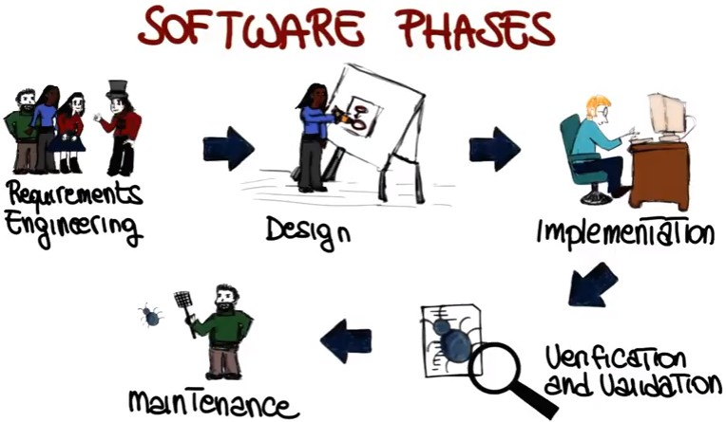
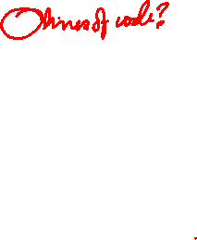
7/26/24
DA-IICT
IT 314: Software Engineering
Software Process and Process Models
1
Software
Q : If you have to write a 10,000 line program in C or Java to solve a problem, how long will it take?
Answers: generally range from 2-4 months Let us analyze the productivity
Productivity = output/input resources
In SW output is considered as LOC
Input resources is effort - person months; overhead cost modeled in rate for person month
Though not perfect, some productivity measure is needed, as project has to keep it high

Slide 2

7/26/24
Software…
The productivity is 2.5-5 KLOC/PM
Q: What is the productivity in a typical commercial SW organization ?
A: Between 100 to 1000 LOC/PM
Q: Why is it low, when your productivity is so high? (people like you work in the industry)
A: What the student is building and what the industry builds are two different things.
What is the difference between a student program and industrial strength SW for the same problem?
Software in 20’s
Much Better
Better processes, practices, and tools are being used Failure rate is dropped to 30-40%
Possible due to the advances in the field of “Software Engineering”

Slide 3
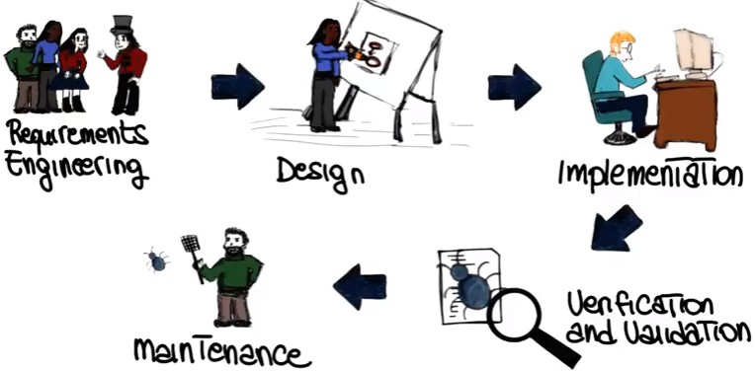
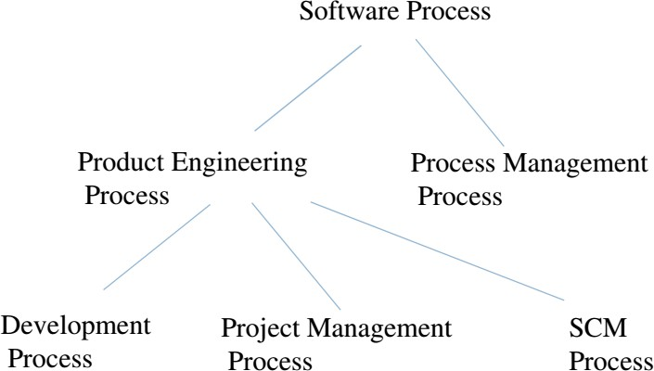
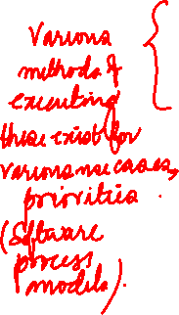
7/26/24
Software Development Life Cycle
Consists of
¤ Requirement gathering, Analysis and Specification
¤ Design (Both high and low level design)
¤ Construction
¤ Testing
¤ Maintenance (Evolution)
¤ Closure
A Dual Emphasis
Product / Project what is done
Process
¤ how things are done

Slide 4
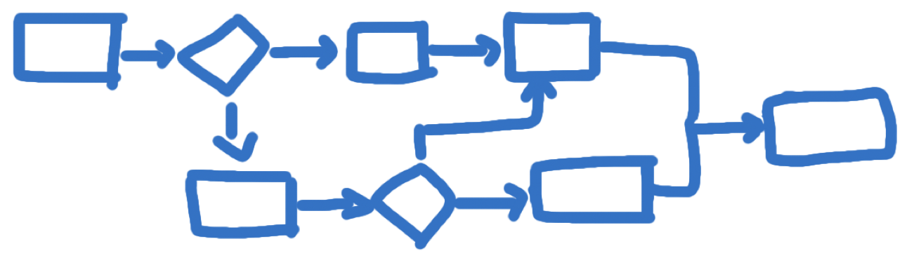
7/26/24
What is a Process
A series of steps involving activities, constraints, and resources that produce an intended outcome of some kind
How a Software Process Help US?
Imposes consistency and structure on a set of activities.
Guides our actions by allowing us to examine, understand, control and improve the activities that comprise the process.
Captures our experience and pass them along to others.

Slide 5
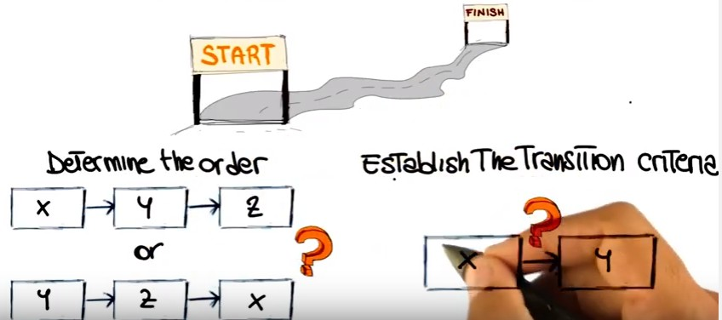
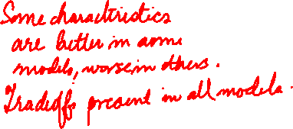
7/26/24
Software Process Characteristics
¤ Visibility
¤ Predictability
¤ Testability
¤ Maintainability
¤ Early defect Removal
¤ Support Change
¤ Customizability
Software Process Models
A (software/system) process model is a description of the sequence of activities carried out in an SE project, and the relative order of these activities.
Determine the order
Establish the transition criteria

Slide 6
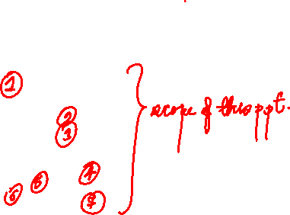
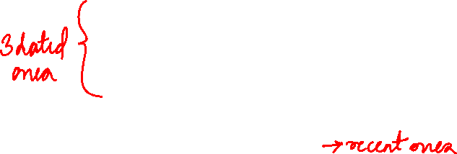
7/26/24
Software Process Models
Also termed as Software Life Cycle Models
Water-Fall model
Prototyping model
Throw away prototyping
Evolutionary prototyping
Incremental model (Evolutionary model)
Incremental Water-Fall model
Time Boxing model
Spiral model
Synchronize & Stabilize model
Commercially projected models like RUP, XP, SCRUM
Software Process Models
By changing the process model, we can improve and/or tradeoff:
Development speed (time to market)
Product quality
Project visibility
Administrative overhead
Risk exposure
Customer relations, etc, etc.
Normally, a process model covers the entire lifetime of a product.
From birth of a commercial idea to final de-installation of last release
i.e. The three main phases: design, build, maintain (50% of IT activity goes here!)

Slide 7
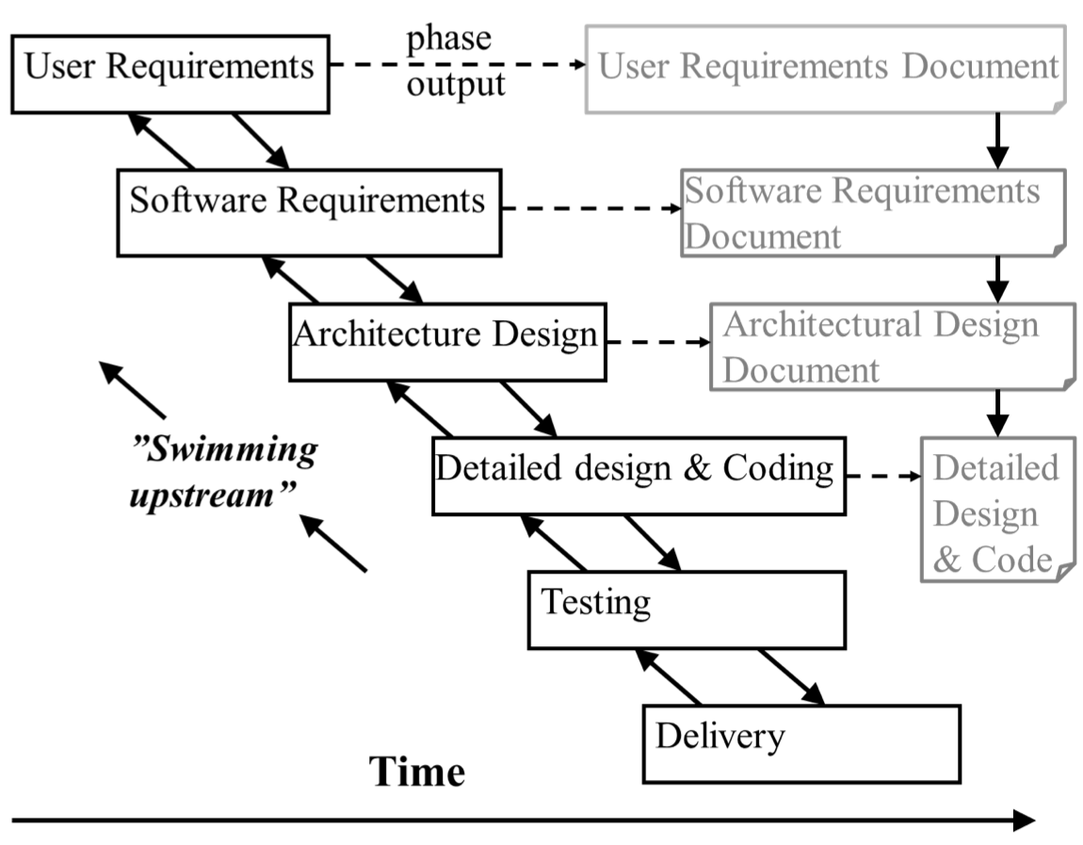
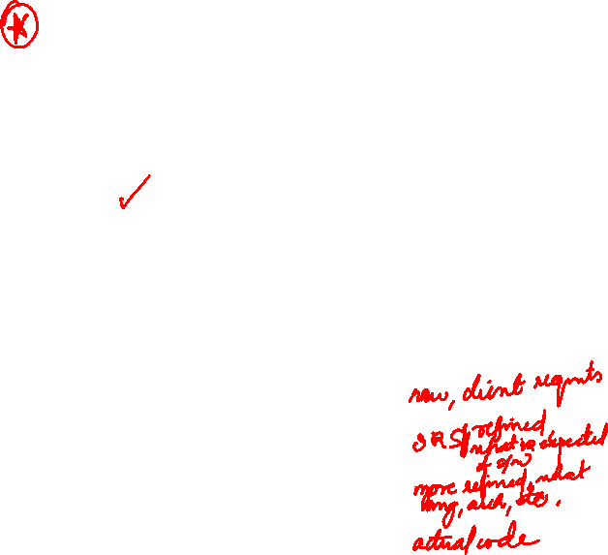

7/26/24
Waterfall Model
One of the first process development models proposed
Works for well understood problems with minimal or no changes in the requirements
Simple and easy to explain to customers
It presents
a very high-level view of the development process
sequence of process activities
Each major phase is marked by milestones and deliverables (artifacts)
Waterfall Model

Slide 8
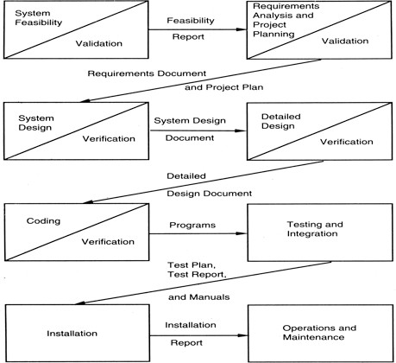
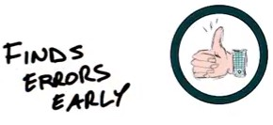


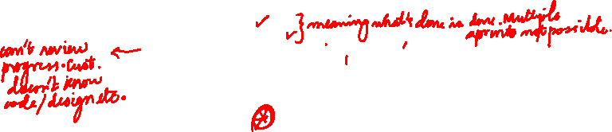
7/26/24
Waterfall Model
Waterfall…
Advantages
Simple
Complete control on the software process
Better quality control
Fits other engineering process models: civil, mech etc.
Reinforces good habits: define-before-design, design-before-code
Disadvantages
Complete and consistent set of requirements?
Do not support iteration
Change management is difficult
Customer to have patience
Does not facilitate good use of resources
May choose outdated technology
Suitable for Well understood problems; Short duration projects; Automation of existing manual systems

Slide 9
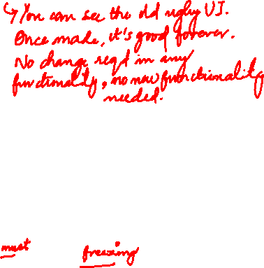
7/26/24
Waterfall…
Waterfall model was used to develop enterprise applications like
Customer Relationship Management (CRM) systems,
Human Resource Management Systems (HRMS),
Supply Chain Management Systems,
Inventory Management Systems,
Point of Sales (POS) systems for Retail chains etc.
Prototyping
Limitations of Waterfall:
Requirements of a system can be frozen
Freezing the requirements usually requires choosing the hardware (because it forms a part of the requirements specification)
Prototyping:
Instead of freezing the requirements before any design or code, a prototyping help to understand the requirements.
Requiremen t
Analysis
Design Code Test
Design
Code
Test

Slide 10
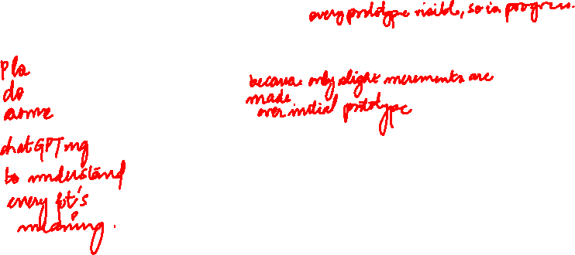
7/26/24
Prototyping…
Evolutionary Prototyping
The task of requirement elicitation is easier (+)
Progress is visible and client is happy (+)
Better use of resources (+)
More flexibility compared to water-fall model (+)
May suffer from “short-sightedness” (-)
May not estimate RISK correctly (-)
Disallows later changes (-)
Prototyping…
Throw-Away Prototyping
The task of requirement elicitation is easier (+)
Progress is visible and client is happy (+)
Better use of resources (+)
More flexibility compared to water-fall model (+)
May improve from “short-sightedness” (+)
May not estimate RISK correctly (-)
Disallows later changes (-)
Difference between Throw-Away and Evolutionary Prototyping??

Slide 11
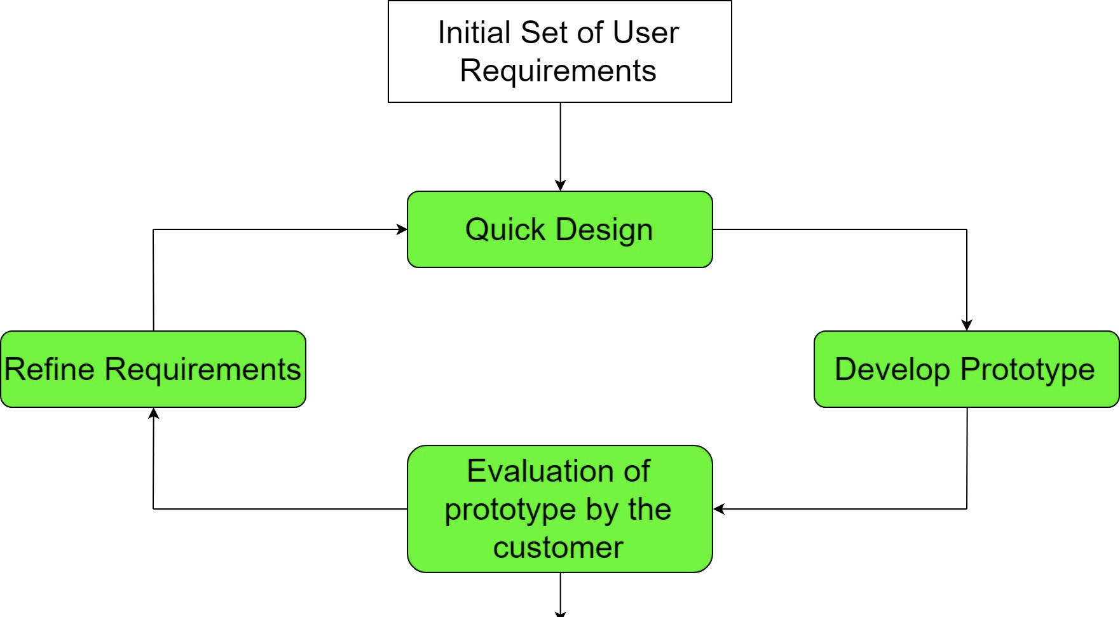
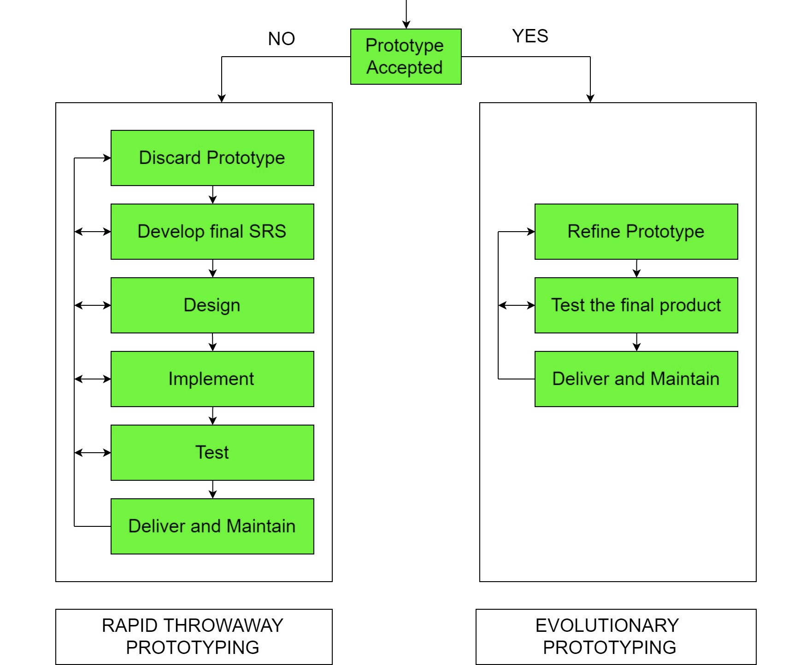
7/26/24
Prototyping…
Prototyping…

Slide 12

7/26/24
Prototyping…
The difference is whether you build on the prototype, or whether you discard it when you have completed.
An evolutionary prototype is one that is built such that it can be expanded upon and revised, but does not have to be discarded and completely rewritten in order to go to market.
A throw-away prototype is something that's designed to capture the "essence" of whatever it is that you're prototyping, but that will be completely replaced by something else that will be what goes to market.
Prototyping Model
Suitable for
Less experience teams
System with novice users
Requirements are not clear
UI is very important

Slide 13
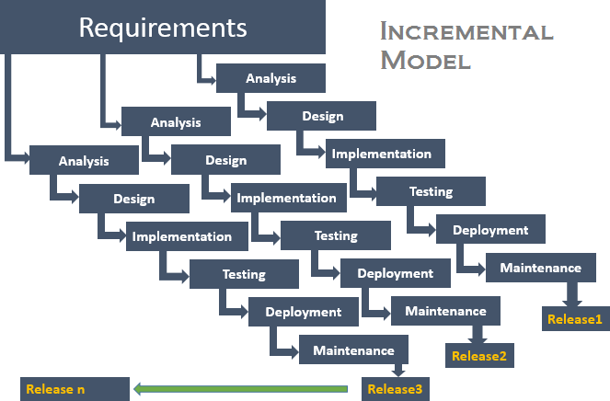
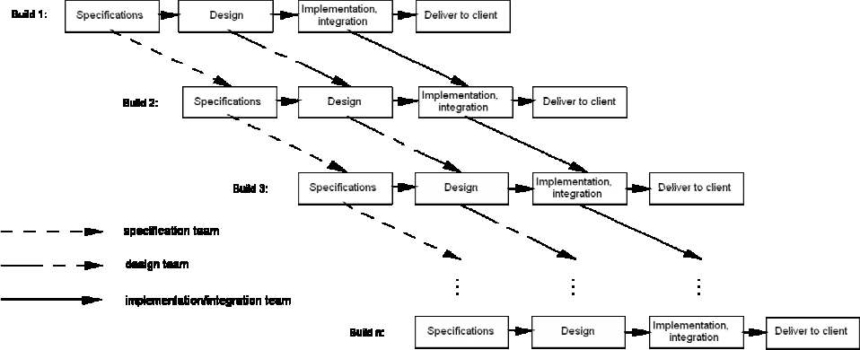
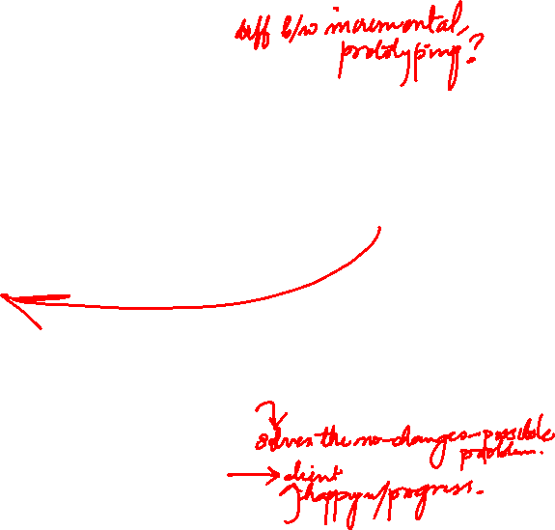
7/26/24
Incremental Model
How Evolutionary prototype model evolve?
Incremental Waterfall Model

Slide 14
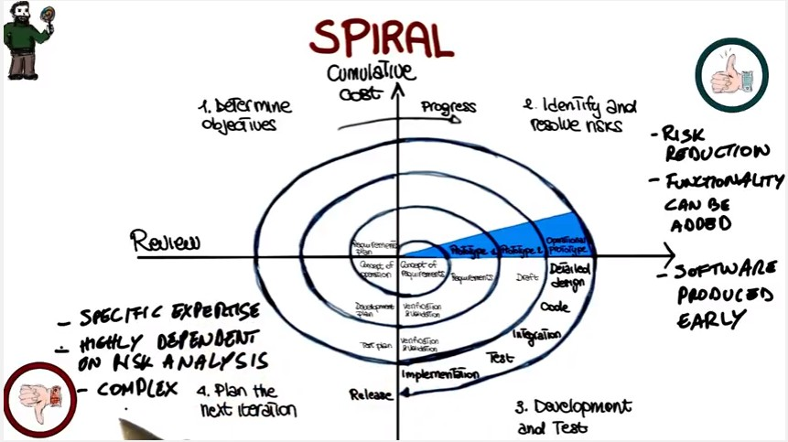
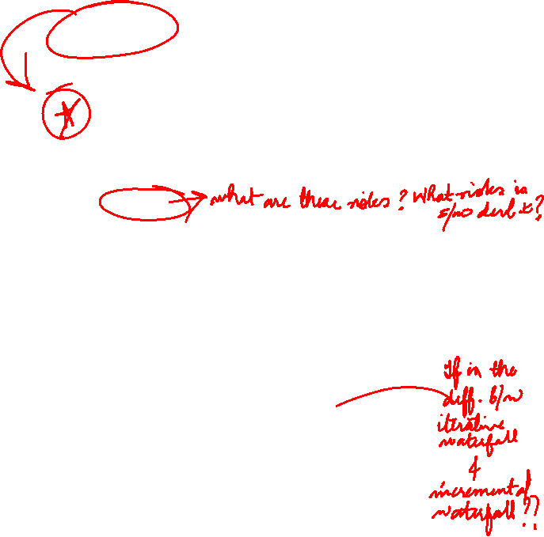
7/26/24
Spiral Model: Incremental model
Always some risk involved in software development
people leave… other products not delivered on time…
Key idea
minimize risk
e.g., building prototypes & simulations minimizes risks
Precede each phase by
looking at alternatives
risk analysis
Follow each phase by
evaluation
planning of next phase
Spiral Model: Combination (Iterative + Waterfall)

Slide 15
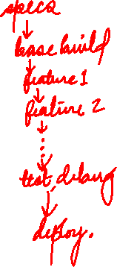
7/26/24
Spiral Model
Advantages
Realism: the model accurately reflects the iterative nature of software development on projects with unclear requirements
Flexible: incoporates the advantages of the waterfal and rapid prototyping methods
Comprehensive model decreases risk
Good project visibility.
Disadvantages
Needs technical expertise in risk analysis to really work
Model is poorly understood by non-technical management, hence not so widely used
Complicated model, needs competent professional management.
High administrative overhead.
Synchronize & Stabilize Model (Microsoft)
Requirements analysis
interview potential customers
Draw up overall product specifications Divide project into 3 or 4 builds
each adds new functionality (1st gives base)
each build carried out by small parallel teams
¤
At the end of day – synchronize (test & debug)
At end of build – stabilize (fix & freeze build)

Slide 16
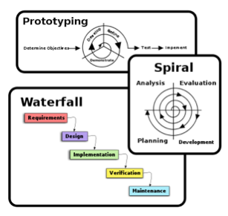

7/26/24
Incremental Model
Suitable for
Risk is high
Requirements are not clear but will evolve
“Time to Market” is critical
Big projects
New concept/product development
Comparison of Process Models
Strengths | Weakness | Type of Projects
Water fall Simple Easy to execute Intuitive and logical | All or nothing approach Requirements frozen early Cycle time too long User feedback not allowed | For well understood problems, short duration project, automation of existing manual systems
Prototyping Helps in requirements Reduces Risk Leads to a better system | Front heavy process Possibly higher cost Disallow later changes | System with novice users When uncertainties in requirements When UI is very important
Iterative/Incremental Regular/quick deliveries Reduces risk Accommodate changes Allow users feedback Allows reasonable exit points Prioritizing requirements | Each planning can have planning overhead Cost may increase as work done in one iteration may have to be undone later | For business where time is of essence Where risk of a long project cannot be taken Where requirements are not known and will be known only with the time

Slide 17
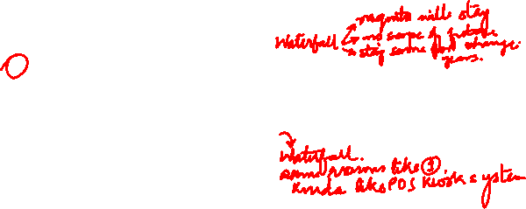
7/26/24
Questions?
Giving reasons for your answer based on the type of system being developed, suggest the most appropriate generic software process model that might be used as a basis for managing the development of the following system.
a system to control anti-lock braking in a car.
a virtual reality system to support software maintenance
a university accounting system that replaces an existing system
an interactive system that allows railway passenger to find train times from terminals installed in stations
Agile Software Development
Agile reduces the risk by delivering the value of the project very early

Slide 18
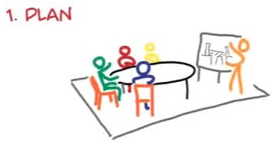
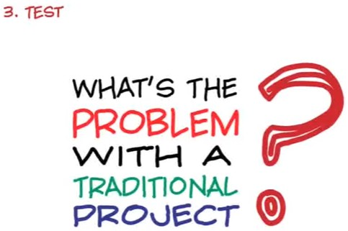
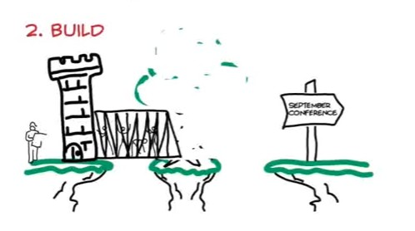
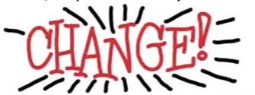
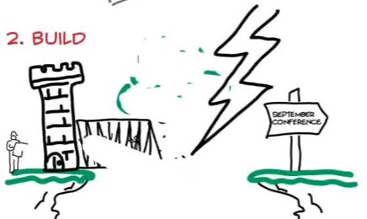
7/26/24
Agile Software Development
Traditional Software Development – Opposed to Agile
Agile Software Development

Slide 19
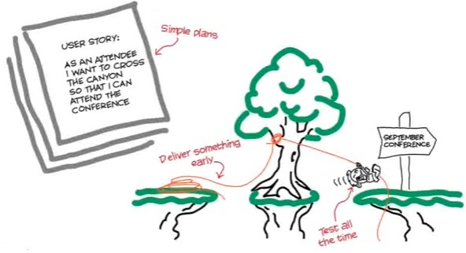
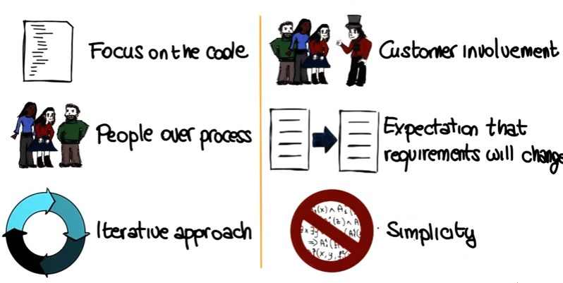
7/26/24
Agile Software Development
Agile Software Development

Slide 20
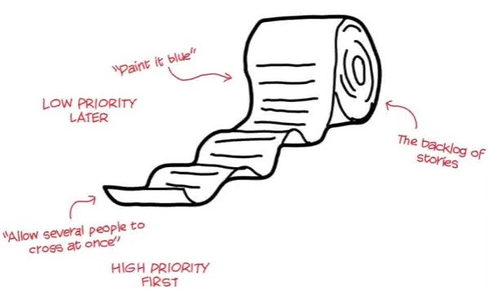
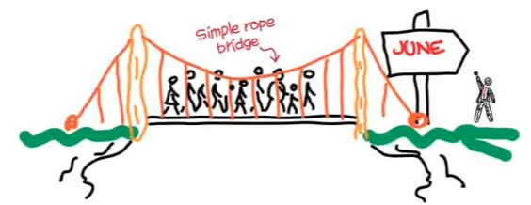
7/26/24
Managing Requirements - Agile
Questions??
Next Lectures…
Other Process Models
(Time boxing, RUP, Agile (XP,
SCRUM) and so on…., CMM

